Slide 1
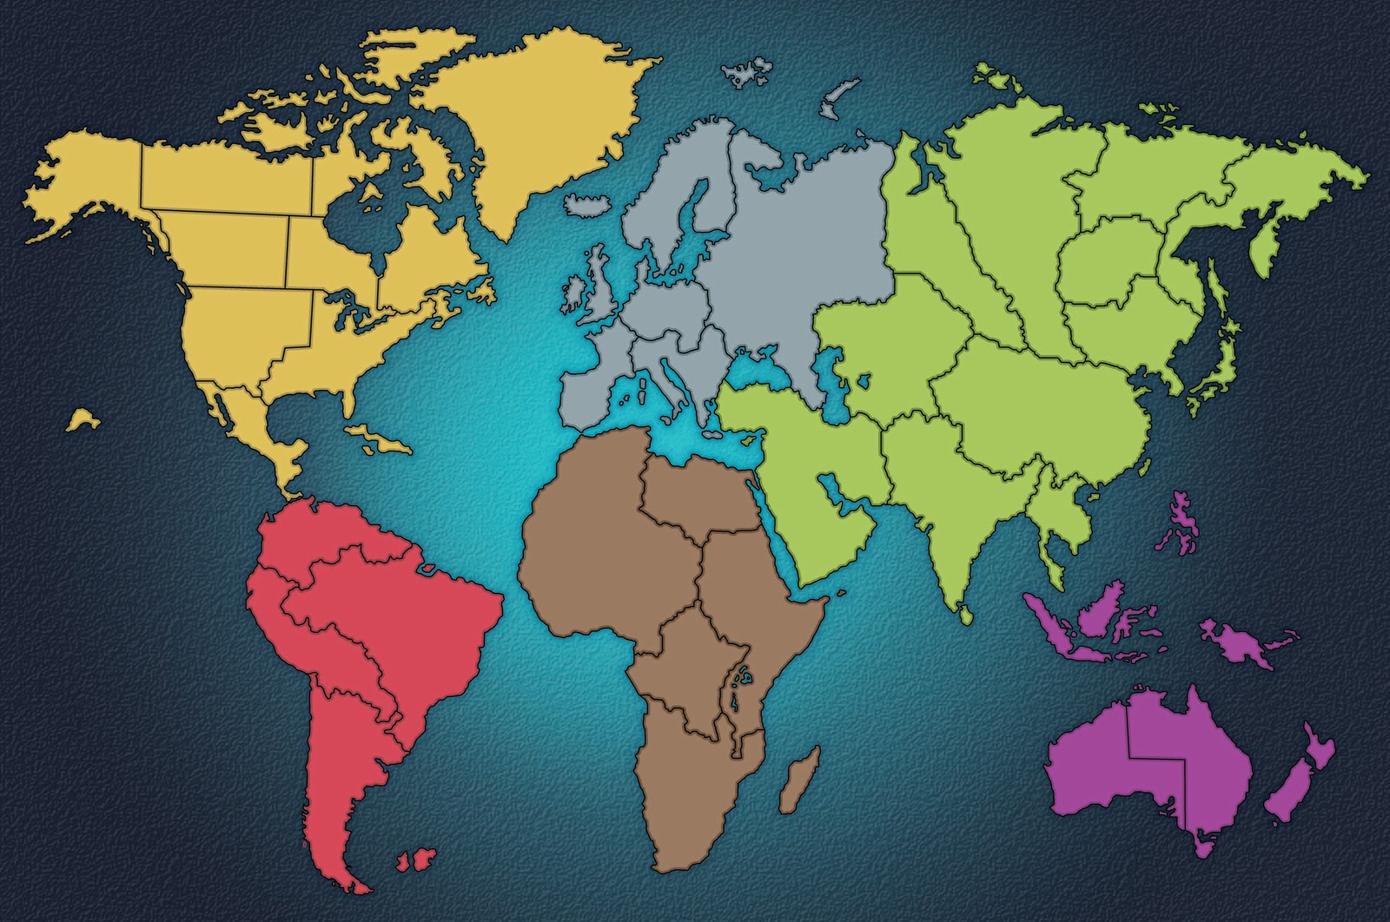
DRisk – a dynamically configurable risk game
Developers:
Chris Darbonne
Jonny White
Bassem Khabiry
Cameron Tooke

Slide 2
Background
Risk is a Hasbro game originally created by the Parker Brothers in 1959.
It is an adaptation of a game created by French film director Albert Lamorisse called La Conquête du Monde ("The Conquest of the World") in 1957.
The object of the game is to take over the map by fighting bordering countries and taking them over one by one.
“Fighting” is accomplished by rolling dice.

Slide 3
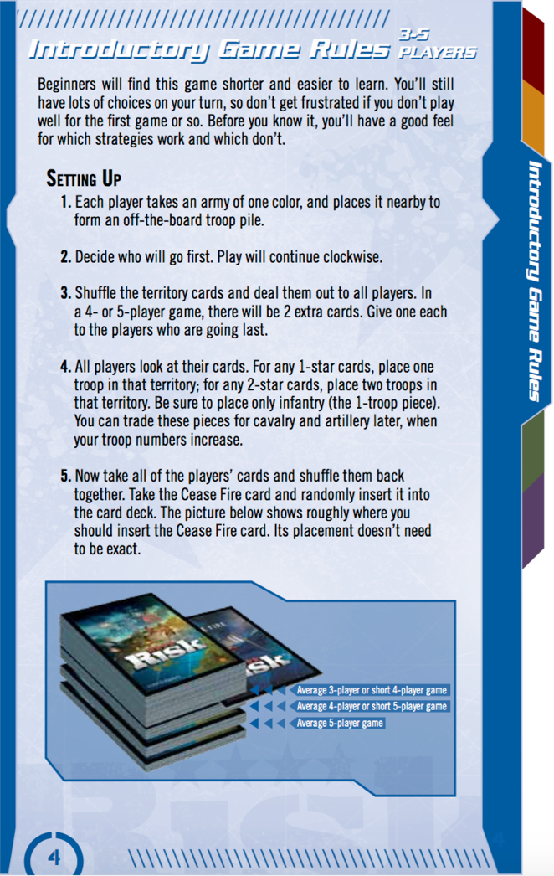

Slide 4
DRisk
Requirements:
Allow for different map granularity, number of players, and difficulty
Allow users to upload custom pictures to be used as maps
Online multiplayer

Slide 5
Project Overview
DRisk is a brower based client written in HTML/Javascript/PHP/CSS
Multipayer implementation is planned to be designed with Ruby on Rails being the MVC framework running on a Linux server
For this phase of release, the client is hosted on localhost and ran through WAMP
Library usage includes JSON and Ammaps
Maps are designed in Photoshop and Ammaps API
Some features include a log-in server and a database to track player information

Slide 6
Game Client
Frontend
HTML5/CSS
Backend
Javascript
JQuery
PHP

Slide 7
Map Library
Ammap.js
~6 KLOC
No documentation
No diversity in names
eg.
“changeColor()” – “colorTo” – “colorMap”
“onMouse” – “mouseDown” – “mousePress”

Slide 8
Map Library
Ammap.js
~6 KLOC
No documentation
No diversity in names
eg.
“changeColor()” – “colorTo” – “colorMap”
“onMouse” – “mouseDown” – “mousePress”

Slide 9
Server Setup
Local Server
XAMPP
MAMP
phpAdmin refuses access when SELECT statements are run incorrectly
Apache does not load on some Macs

Slide 10
Team Structure
Chris – Team Lead
Project structure
Game functionality
Web Frontend
Debugging
Jonny
Game functionality
Server setup
Debugging
Cameron
Maps
Cards
Bassem
PHP/MySQL
Database
Server setup

Slide 11
Team Connection
Meetings
Once a week
Subversion
Github
File hosting
Merge manager
Project Management
Asana
Team discussion
Schedule management

Slide 12
Schedule

Slide 13
Schedule

Slide 14
Scalable Vector Graphics
Scalable Vector Graphics (SVG) are the design framework used to create our maps.
SVG allow scaling that not possible in JPEG/PNG image formats
Can assign a wide variety of event handlers, such as onMouseOver and OnClick

Slide 15
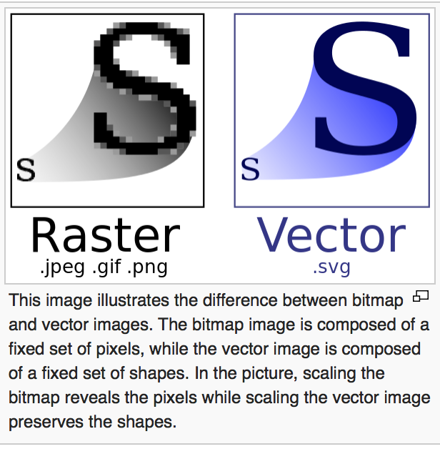
Advantages of SVG
Supported on all popular web browsers
Can be scaled to any resolution and maintain high quality
Unlike JPEG/PNG, SVG do not consist of pixels, only shapes and attributes for these shapes
We can create these images in Notepad++ or any other text editor
Requires less bandwidth and resources

Slide 16

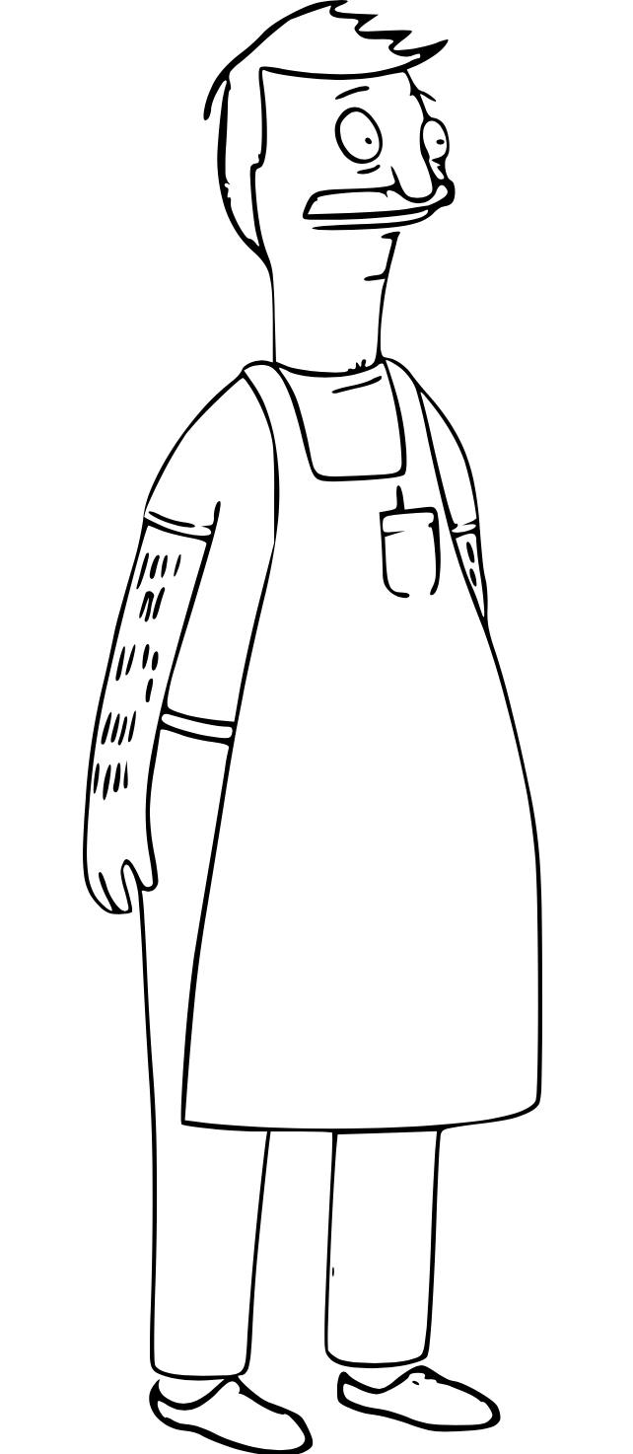

Slide 18
Interactive Map Creation
Drawing/connecting paths in Adobe Illustrator and saving under layers
Exporting finished paths and layers to a .SVG document
Converting XML path format to AMmap’s JavaScript format

Slide 19
Path Creation Demo
https://youtu.be/9fn2OuDECzc

Slide 20
.SVG to JavaScript Format

Slide 21
Maps
World (Hard)
6 continents
42 territories

Slide 22
Maps
World (Medium)
6 continents
21 territories

Slide 23
Maps
World (Easy)
6 continents
12 territories

Slide 24
Maps
Khorvaire
3 continents
16 territories
based off a continent from the Dungeons and Dragons Universe

Slide 25
Maps
United States
6 regions
48 territories

Slide 26
Maps
Easteros
9 regions
70 territories

Slide 27
Card Creation

Slide 28
Card Creation

Slide 29
Server
We are hosting a MAMP server.
Create the database in my SQL and connected with php.

Slide 30
Web interface
Using HTML, PHP to create the webpage.

Slide 31
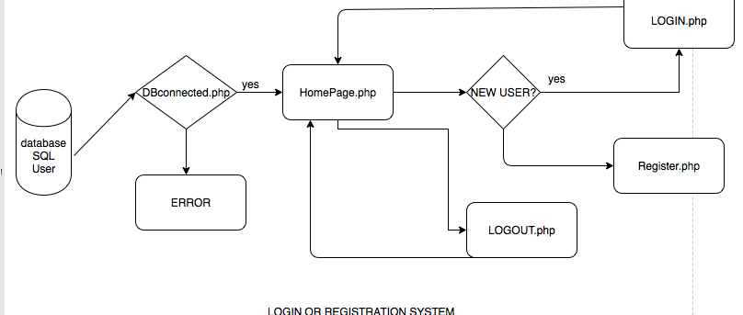
FLOW CHART

Slide 32
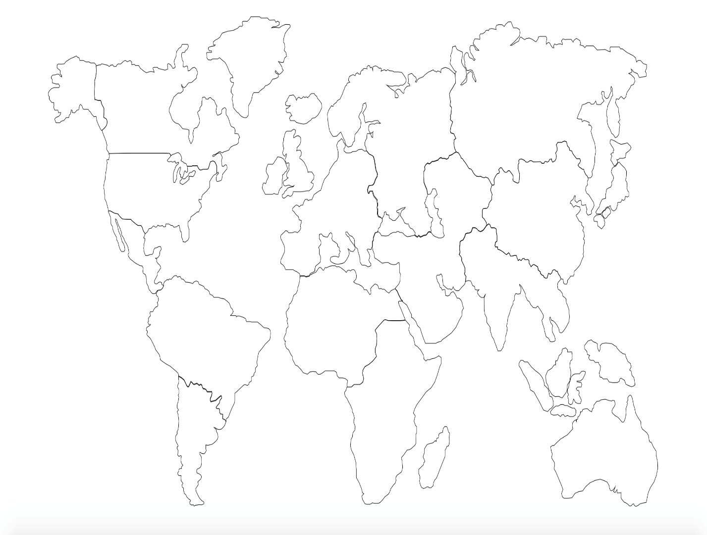
Problems Encountered

Slide 33
Cont.
M1046.8,3654.5l-1.5,6.3l-5.3,7.1l-5.4,5.7l-6.2,3.7l-6.5,2l-6.7,1l-8,0.2l-7-1l-7.7-1.6l-8-0.4H965l-10.8-0.3l-10.3-0.8l-4.8,1.3l-7,1.4l-8.3,1.4h-9l-3.5-1.8l-9.8,0.3l-6-1c0,0-5.8-0.5-8.3-3.8s-6-7.3-6-7.3l-3.8-6l-0.8-4.8l-2.3-4c0,0-2.5-6-6.8-2.3s-11.5,7.5-11.5,7.5l-5,1.5l-9,2.3l-6.8,2.8l-5.3,3.8l-6,2.3l-10.5,2l-5.3,5l-5.8,2.8l-6.3,2.8l-6.8,3h-6l-4-1l-2.3-3l-4.5-1.3l-9.8,0.5l-13,0.3l-9,1.6l-12.5,0.9h-6l-6.3,1.8l-4.8-0.5l-6.3-2.5l-3.5-2.5l-3.3-1.8l-5.3,2l-4.8,0.5h-5l-5.5,1.5l-5.5,2.5h-4l-4.5-0.5l-4.8-4.5l-2.5-3.3l-2.3-3.3l-6.8-3l-10.3-10.3l-3.5-4l-3-1l-6-2.8l-3.5-3.3l-5.5-6c0,0-3-4-2.3-6.5s2.5-11,2.5-11l-1-5l-0.3-5l2.3-7.5l0.8-6.5l2.5-9.5l1.3-10l1.3-11l-0.5-7.8l-2.3-5.8l-3.8-6.8l-3-7c0,0-0.8-7.3-0.8-8.8s2.3-6.5,2.3-6.5l6-3.3c0,0,5-0.8,8.3-5.5s5-9.5,5-9.5l2.8-2.8v-3.3l-0.3-5l2-3.9l4.3-4.6h1.5c0,0,2.6,0.8,4.6,0.3s7.1-1.3,7.1-1.3h7.3h9.5h7.5l9-0.8c0,0,4.8-0.4,5.8,1.6s20.3,0.1,20.3,0.1h37l11.5-1.5l7-0.8l7.5,0.5l7-0.8l14.5-0.5l15.3,1.5l25.8-1l27.3-0.8l15.8-0.8l10.8-1.5l1.8-0.5h5l6.5-0.5l8.8-0.5l15.8,0.3l12.8-0.3c0,0,6-0.5,7.3,5.3s6.8,12,11.5,9.8s4.5,4.8,4.5,4.8l-0.3,4.5l3.8,7.3l3.8,6l2.8,0.8l4.3,0.3l3.3,3.3l4.5,4.3l3.3,2.8l-1,7.8l-0.3,6.3l0.5,11c0,0,2.3,4,7,3s9.3-1.3,9.3-1.3l3,9l2.3,8.3l1.8,7.3c0,0,2.1,3.8,4.4,2s5.4,0.5,5.4,0.5v5l3,3l4.3,4.3l4.5,6l5,4.5c0,0,1.8,4.8-0.5,5.3s-7.3,0.3-7.3,0.3s-2.3,3-0.3,5.3s5.5,5.8,5.5,5.8l1.3,5.5l0.3,7l0.8,5l2,5.3l2.5,4.8L1046.8,3654.5z"

Slide 34
Cont.
<polygon class="st0" points="891,1023.1 893.8,1028.5 902.4,1030.1 909.8,1028.2 915,1024 917.5,1019.5 923,1019.5 928,1019.5 929.3,1025.7 936.5,1029.9 945,1033.5 952,1033.5 961,1033.5 960,1028.5 962.7,1024.7 968.3,1022.5 972.5,1019.5 971.7,1014.2 969.3,1006 965.8,998 966.3,988.7 969.7,979.8 972.5,988.2 974.5,996.2 975.8,1003.2 979.5,1012.5 979.5,1019 979.5,1025 981.5,1031.3 987.5,1032.2 993.8,1028.3 996.7,1025.7 1002.3,1025.2 1007,1027.8 1012.7,1029 1016.2,1024.7 1018.7,1020.2 1019.5,1016.7 1023.7,1014.2 1026.7,1010.3 1029.7,1009.7 1035,1012.8 1042.7,1015.3 1051.8,1015.7 1056.7,1013 1060.7,1012.2 1061.3,1005.5 1062.5,1001.7 1062.5,995 1060.8,989.8 1064.5,982.3 1068,975.5 1067,968.7 1074.5,964.5 1083.7,961.2 1087.8,954 1093.5,951.3 1099.9,948.2 1098.5,941 1098.5,934 1097.3,925 1090.2,921.8 1083,921 1077.8,915.3 1071.3,912.7 1061.7,911.3 1056.8,908.8 1053.3,907.2 1047.4,902 1045.5,890.3 1045.5,884 1042.3,880.8 1038.5,882.3 1036.7,885 1035.8,888.5 1033,894 1029.7,894.2 1024.7,896.5 1024.3,899.7 1021.8,904.2 1018.5,907.2 1012.8,909 1006,910 1003.9,910.4 1004.7,908.3 1003.5,907.2 998,903 996.7,896.7 1002.7,887.7 1007.7,881.7 1006.7,875.3 1011,862.7 1007.8,852.3 998.7,834.7 1001.7,823 1010,808.7 1017,796.7 1022.7,783.7 1029.8,779.7 1035.3,771.7 1034.7,763.5 1038.5,755 1038.5,743.3 1034.9,722.9 1031.4,702.6 1029,695.6 1021,689.1 1020,689.8 1011.5,696.8 1003.8,705.8 1001.5,724.5 1005.3,732.8 1001.5,736 990.5,741.3 974.8,752.5 962.8,761.3 950.3,766 946.8,773.3 940.8,779.3 928,785.5 915.5,797 905,809 891.8,814.8 879.5,819 862.5,826.5 852.8,828.8 838.7,834.3 833.5,837.3 833.5,839.3 845.2,843.3 855,848.2 869.3,856.5 876.7,861.5 877.5,867.7 874.7,875.8 875.7,887 875.8,894.2 876.8,906.8 880.5,921.7 887,932.5 891.5,940.5 890.8,949.3 896,961.2 899.5,969 899.5,977 897.5,986.2 897.5,997 894.8,1008.5 891.8,1014.5 891,1019.7 891.2,1021.3 "/>

Slide 35
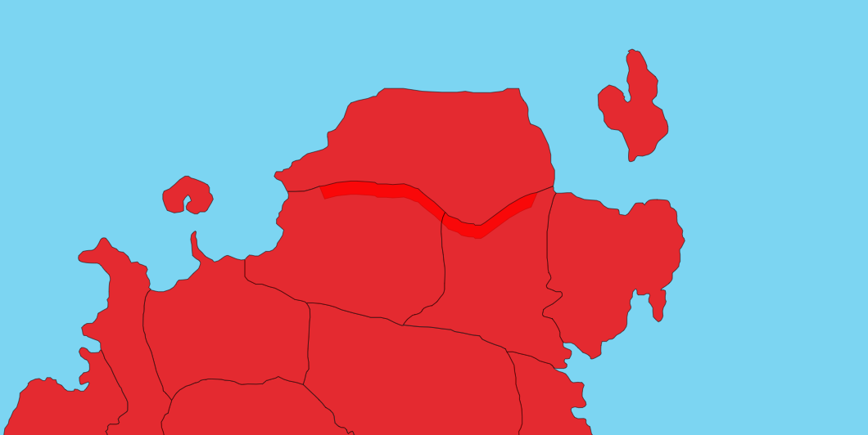
Cont.

Slide 36
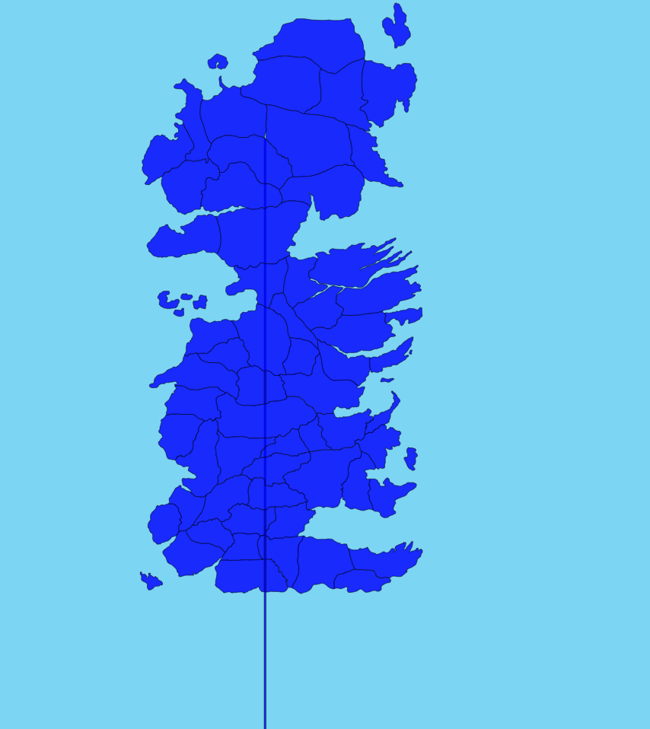
Cont.

Slide 37
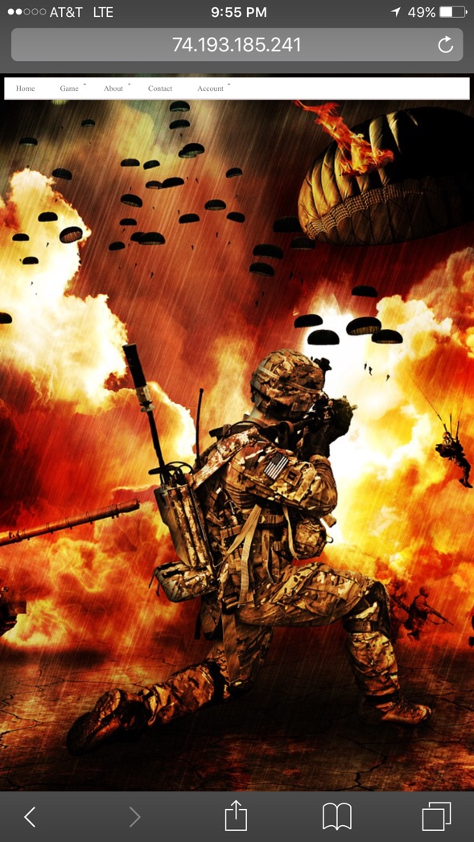
Cont.

Slide 38
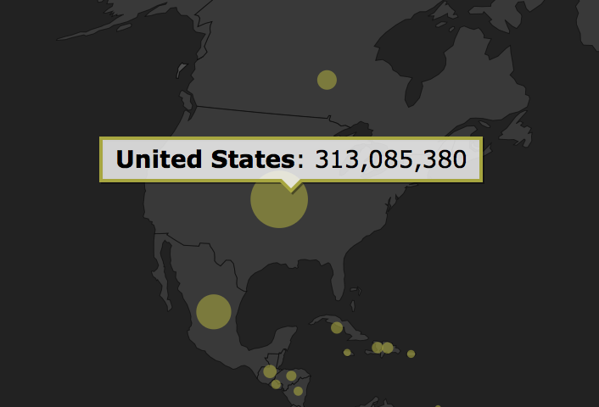
Display Army Totals

Slide 39
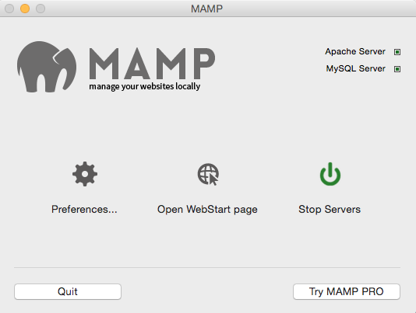
Server

Slide 40

Webpage

Slide 41
HTML and JQuery code
(function(){
var form = $('#login-register');
form.on('submit', function(e){
if(form.is('.loading, .loggedIn')){
return false;
}
var email = form.find('input').val(),
messageHolder = form.find('span');
e.preventDefault();
$.post(this.action, {email: email}, function(m){
if(m.error){
form.addClass('error');
messageHolder.text(m.message);
}
else{
form.removeClass('error').addClass('loggedIn');
messageHolder.text(m.message);
}
});

Slide 42
CSS code
#cssmenu {
z-index: 1000;
}
#cssmenu > ul {
width: auto;
list-style-type: none;
padding: 0;
margin: 0;
background: #ffffff;
border: 1px solid #ece6e8;
border-bottom: 3px solid #d9ced2;
-webkit-border-radius: 2px;
-moz-border-radius: 2px;
-o-border-radius: 2px;
border-radius: 2px;
}
#cssmenu > ul li#responsive-tab {
display: none;
/* Hide for large screens */

Slide 43
PHP code
<?php
session_start();
include_once 'dbconnect.php';
if(isset($_SESSION['user'])!="")
{
header("Location: home.php");
}
if(isset($_POST['btn-login']))
{
$email = mysql_real_escape_string($_POST['email']);
$upass = mysql_real_escape_string($_POST['pass']);
$email = trim($email);
$upass = trim($upass);
$res=mysql_query("SELECT user_id, user_name, user_pass FROM users WHERE user_email='$email'");
$row=mysql_fetch_array($res);
$count = mysql_num_rows($res); // if uname/pass correct it returns must be 1 row
if($count == 1 && $row['user_pass']==md5($upass))
{
$_SESSION['user'] = $row['user_id'];
header("Location: homepage.php");
}
else
{
?>
<script>alert('Username / Password Seems Wrong !');</script>
<?php
}
}

Slide 44
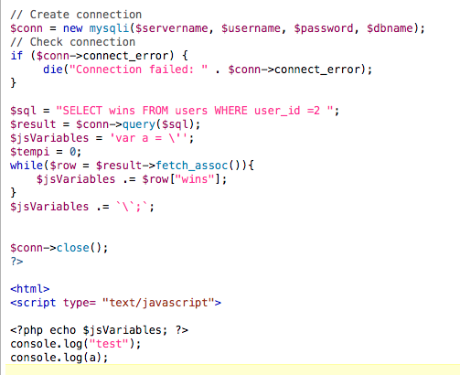
Issues
textWrangler does not recognize php inside of a script tag

Slide 45
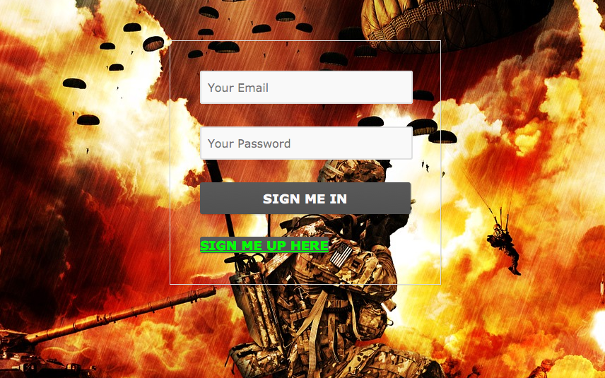
Login and Registration System

Slide 46
FLOW CHART

Slide 47
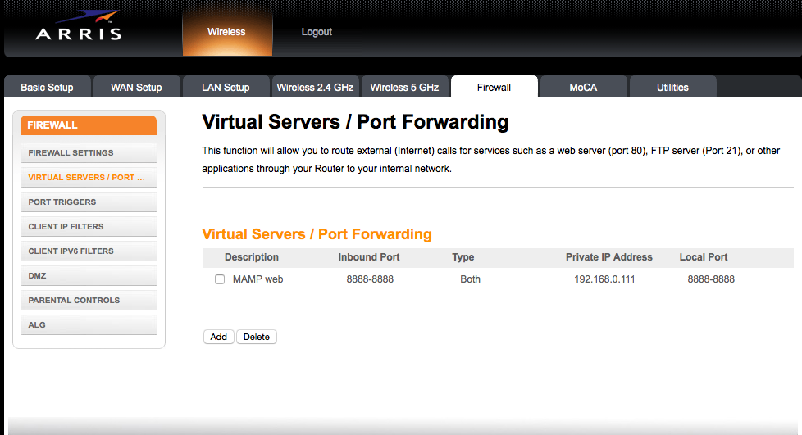
Remote Access

Slide 48
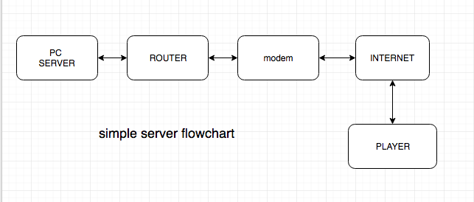

Slide 49
Future Plans
Secret Missions
Online Multiplayer
iOS/Android Integration
Dynamic Card Creation
More Game Types/Rules

Slide 50
DEMO

